Slide 1


PES INSTITUTE OF TECHNOLOGY DEPARTMENT OF COMPUTER SCIENCE AND ENGINEERING PROJECT WORK PROJECT TITLE: AN ONLINE FOOD DELIVERY SYSTEM ACADEMIC YEAR 2023-2024 TOPIC:TEXT-TO-IMAGE GENERATION
UNDER THE GUIDANCE OF: PRESENTED BY:
Mr. Anand SubbaRao HARSHITHA.G.N. (PES1PG22CS017)
ASSISTANT PROFESSOR, VIDYA.M (PES1PG22CS055)
DEPARTMENT OF CSE, MEGHA.B (PES1PG22CS023)
PES. M.TECH 3RD SEM.

Slide 2
ABSTRACT
ABSTRACT :
The Online Food Delivery System using Python is a web-based application designed to streamline the process of ordering and delivering food from various restaurants to customers' doorsteps. The system employs a Python-based framework, providing a user-friendly interface for both customers and restaurant owners. Key features of the system include order placement, menu browsing, real-time order tracking, and secure online payment options. To enhance user experience, the system incorporates a recommendation engine that suggests popular dishes based on user preferences and ordering history. The application is built on a scalable and modular architecture, making it easy to integrate with different databases and adapt to the evolving needs of the food delivery industry. The use of Python ensures efficient development, rapid deployment, and easy maintenance of the system. Furthermore, security measures, such as data encryption and secure payment gateways, are implemented to safeguard user information and transactions.
The Online Food Delivery System using Python is a comprehensive solution that caters to the growing demand for convenient and efficient food delivery services. Its user-friendly interface, advanced features, and robust architecture make it a valuable tool for both customers and restaurant owners in the dynamic online food delivery ecosystem.

Slide 3
INTRODUCTION
INTRODUCTION :
The Online Food Delivery System serves as a digital intermediary, connecting customers with their favorite eateries and facilitating seamless transactions. Harnessing the power of Python, a versatile and widely-used programming language, the system offers a robust and scalable solution to meet the dynamic needs of the modern food delivery landscape. This system is structured around three main components: the Customer Module, the Restaurant Module, and the Admin Module. Each module plays a crucial role in ensuring a smooth and efficient workflow. Customers can explore restaurant menus, place orders, and make secure online payments through an intuitive and user-friendly interface. Restaurant owners, on the other hand, can manage their menus, update prices, and monitor and fulfill incoming orders, all within the dedicated Restaurant Module. The Admin Module oversees the entire operation, managing user accounts, overseeing order transactions, and resolving issues to maintain a seamless user experience. To enhance user engagement and satisfaction, the system incorporates intelligent features such as a recommendation engine, which suggests popular dishes based on user preferences, and real-time order tracking using GPS technology. These elements contribute to a personalized and efficient food ordering experience. Built on a modular and scalable architecture, the Online Food Delivery System using Python is well-equipped to adapt to the evolving demands of the food delivery industry. The choice of Python as the programming language ensures rapid development, easy maintenance, and the ability to integrate with various databases and technologies. Security measures, including data encryption and secure payment gateways, are implemented to safeguard user information and transactions, fostering trust in the system.

Slide 4
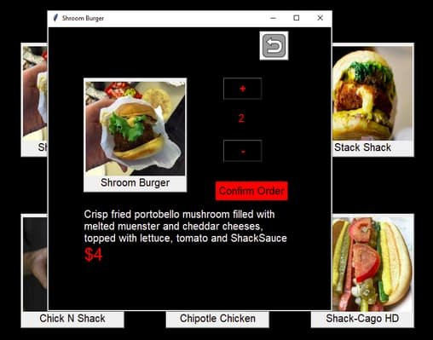
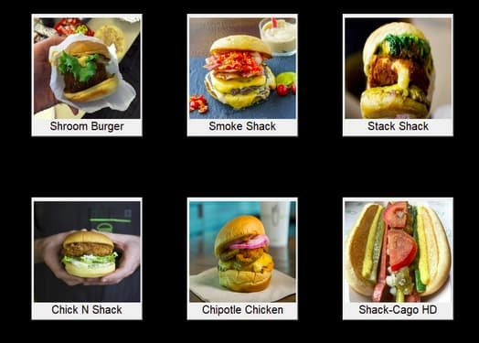
INTRODUCTION

Slide 5
FUNCTIONALITIES
FUNCTIONALITIES:
Provides search options based on a variety of criteria. like Food Item, Customer, Order,
and Order Confirmation.
Online food ordering systems also manage payment information for order details, order
confirmation details, and food items online.
It keeps track of all the data regarding Categories, Payments, Orders, etc.
Manage the category's details.
Displays the food item's information and description for the customer. Easy to manage the
Food Item, Category more effectively.
It focuses on keeping track of order's data and transactions.
Manage the food item's information.
Improvements in editing, adding, and updating records lead to proper resource
management of food item data.
Manage the order's information by combining all Confirm Order data.

Slide 6
FEATURES
FEATURES:
Based on products and components.
Easily creating and altering issues.
Issue List can be queried in any detail.
Reporting & Charting in a more thorough manner.
User accounts are used to manage access and uphold security.
Straightforward status & resolutions.
Priorities and severity levels at various levels as well as targets and milestones for the programmers to follow.
A solid database back end.
Various levels of reports are provided with many filtering options.
Accuracy in the work.
Information retrieval is simple and quick. nicely crafted reports.
Reduce the workload of the person using the current manual system.
Individual access to any information.
Work progresses quickly. Simple information updates.
.

Slide 7
SYSTEM MODEL
SYSTEM MODEL: Creating a system model involves representing the components, interactions, and relationships within the system.
When ordering food online, you can view feedback about the restaurants and apps offered through the app. After reading the feedback, users can get food at an excellent restaurant. The business models are very intuitive and understandable. The website is a three-part business plan. The software earns revenue through advertising on social platforms and advertising at restaurants.
The stakeholder is the customer who orders food, individuals with their vehicles, and customers.
Connections : The application allows Android and iOS owners to register vehicles using their crews for services.
Customers : The application allows customers to try different cuisines and order food with ease anytime.
This system model provides a high-level overview of the key components and interactions within the Online Food Ordering System, emphasizing the modular structure and the integration of various technologies to deliver a seamless user experience.

Slide 8
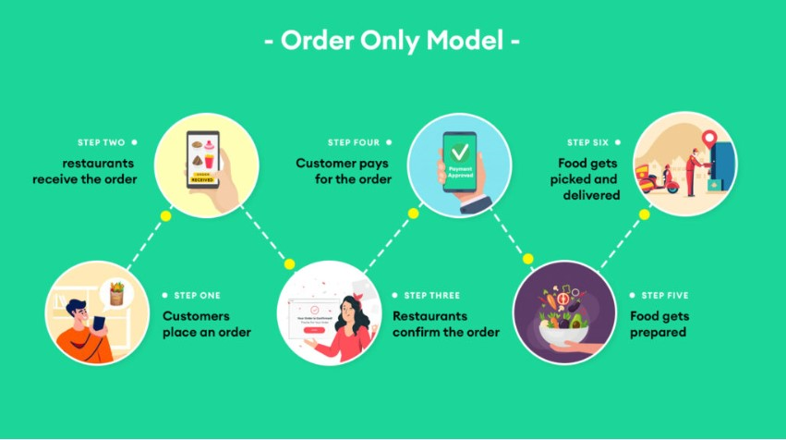
SYSTEM MODEL
SYSTEM MODEL:

Slide 9
SYSTEM ANALYSIS
SYSTEM ANALYSIS:
FUNCTIONAL REQUIREMENTS:
User Registration
Menu Browsing
Order Placement
Secure Online Payments
Menu Management
Order Fulfillment
User Account Management
Transaction Monitoring
Issue Resolution

Slide 10
SYSTEM ANALYSIS
SYSTEM ANALYSIS:
NON-FUNCTIONAL REQUIREMENTS:
Scalability
Uptime
User Authentication
Data Encryption
Fault Tolerance
Intuitive UI
Compliance

Slide 11
DEVELOPMENT MODEL
DEVELOPMENT MODEL:
System Design : The system design is created in this phase after studying the requirement specifications from the first phase. This system design aids in determining the overall system architecture as well as the hardware and system requirements.
IMPLEMENTATION : The system is initially built in discrete programs known as units, which are
then combined in the following phase, using inputs from the system design. Unit testing is the
process of developing and evaluating each unit for functionality.
INTEGRATION AND TESTING : Following the testing of each unit created during the implementation phase, the entire system is merged. The entire system is tested for errors and failures after integration.
DEPLOYMENT OF SYSTEM : Once the product has undergone functional and non-functional testing, it is either published to the market or deployed in the customer's environment.
MAINTENANCE : Various problems can arise in a client environment. Patches are published to
address certain problems. Additionally, improved versions of the product are issued. To bring
about these changes in the surroundings of the consumer, maintenance is performed.

Slide 12
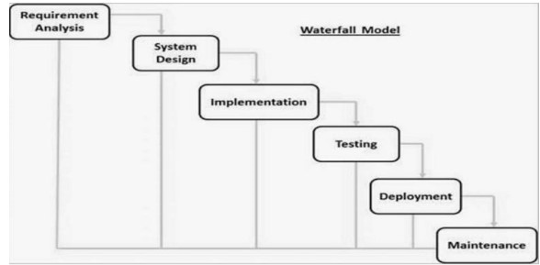
DEVELOPMENT MODEL
DEVELOPMENT MODEL:

Slide 13
SYSTEM REQUIREMENT SPECIFICATION
BACKEND: Python, leveraging the framework for scalability and maintainability.
FRONTEND: HTML, CSS, and JavaScript, with consideration for modern frameworks such as React or Vue.js for enhanced user interfaces.
DATABASE: Utilization of robust database systems like PostgreSQL or MySQL to ensure data integrity and reliability.
REAL-TIME FEATURES: Implementation of WebSockets to facilitate real-time interactions.
PAYMENT INTEGRATION: Integration of popular payment gateways such as Stripe, PayPal, or other relevant APIs.

Slide 14
CONCLUSION
CONCLUSION:
The development and implementation of an advanced online food delivery system represent a significant stride in meeting the evolving needs of today's dynamic consumer base. This project aimed to create a feature-rich platform, drawing inspiration from successful industry models like Swiggy and Zomato, to provide a seamless, convenient, and delightful experience for both users and businesses.
Through the incorporation of cutting-edge technologies, such as Python and associated frameworks, we have crafted a scalable and robust backend infrastructure. This ensures the efficient management of user data, order processing, and logistics, laying the foundation for a high-performance system capable of handling the demands of a rapidly growing user base. The integration of secure payment gateways not only facilitates seamless transactions but also establishes trust, a crucial factor in the success of any online service. Multiple payment options cater to diverse user preferences, ensuring inclusivity and convenience in the payment process. this project aspires to elevate the online food delivery experience, not merely as a transactional service but as a seamless, personalized, and reliable solution that anticipates and exceeds user expectations. As technology continues to evolve, this system stands ready to adapt and innovate, ensuring its relevance and effectiveness in the ever-changing landscape of the food delivery industry.

Slide 15
THANK YOU

